Slide 1
Welcome to our Maths Workshop
Now officially a Numicon Advocate School

Slide 2
Maths Teaching and Learning at Bartons
‘GOOD Mathematics is not about how many answers you know…
It’s how you behave when you don’t know.’

Slide 3
Teaching and learning with Numicon has enabled:
A love of Maths
Consistent good teaching
Excellent progression
Accelerated Progress

Slide 4
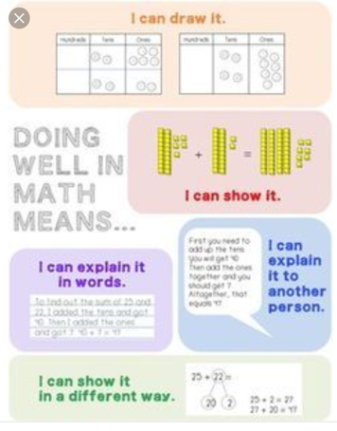
The Numicon approach develops thinking and deeper understanding.
We develop the children’s skills so that they can do this

Slide 5
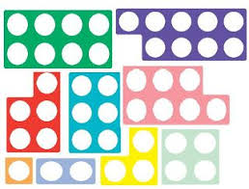
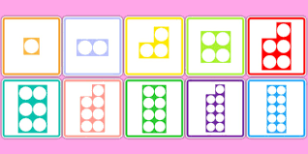
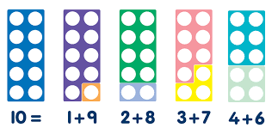
The Numicon approach uses shapes and manipulative resources to represent maths concepts clearly for children.
Times tables are essential for children’s maths understanding

